Slide 1
The Use of Formal Methods in Verifying Behavior of Autonomous Vehicles
Alyssa Byrnes

Slide 2
Motivation
Car software systems are very complicated...The GM Volt contains +10M lines of code
How do we verify that it behaves correctly?
Formal methods add automation to checking this
The correctness of a system = expected behavior of the system.

Slide 3
How it works
Specification
Take existing system.
Create a specification of that system.
Prove that the specification accurately represents the system.
Prove properties about system by proving properties about the specification.

Slide 4
What is a specification?
Specification
“A specification can be regarded as a description that is intended to be as precise, unambiguous, concise, and complete as possible in the contexts of its specific application .
A formal specification is a specification written in a formal language…”[1]

Slide 5
Basic Logic Introduction
Atoms: A,B∈{True, False}
Operations: ㄱ, ⋀,⋁
Notes:
As logic is a key part of formal methods, we will do a brief introduction to propositional logic and temporal logic, since these are two of the most commonly used logics in formal methods.

Slide 6
Temporal Operators
Fp - p holds sometime in the future.
Gp - p holds globally in the future.
Xp - p holds next time.
pUq - p holds until q holds.

Slide 7
Model-based vs. Algebraic Specification
Model Based
Explicit specification of abstract machines
System is specified using mathematical entities (sets, sequences, etc.) and operations are defined by how they affect those states.
Algebraic/Property-Oriented
Abstract data types specified by axioms defining relationships between its operations

Slide 8
Main Methods of Formal Verification
Model checkers
Symbolic Executers
Theorem Provers
Notes:
There are many methods of formal verification being used currently, but the three main types are model checkers, symbolic executers, and theorem provers. These methods can be used separately or in conjunction with eachother.

Slide 9
Model Checkers
A model checker verifies a system against a set of specified properties.
Usually the system is specified as a set of finite state machines, and the properties are expressed using a temporal logic.
The model is typically built in one language, and then verified using a separate model checker.
Notes:
Give example of some model/model checker pairings.

Slide 10
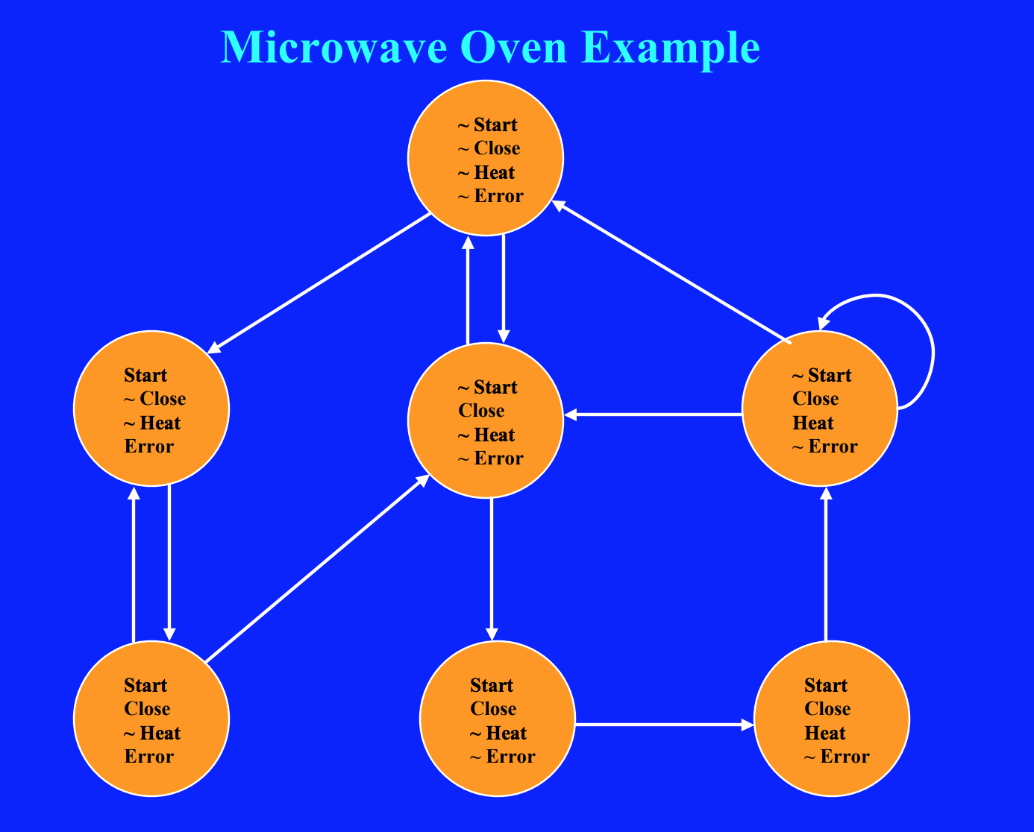
Model Checker Example
Example property: The oven doesn’t heat up until the door is closed.
(ㄱheat_up) U door_closed
Notes:
As you can see from how complicated the model of just a simple microwave oven is, you can imagine these models get really large really quickly. This is called the state-explosion problem. A lot of work has been done in solving this problem, including work in eliminating redundant states and bounding the amount of execution traces to test.

Slide 11
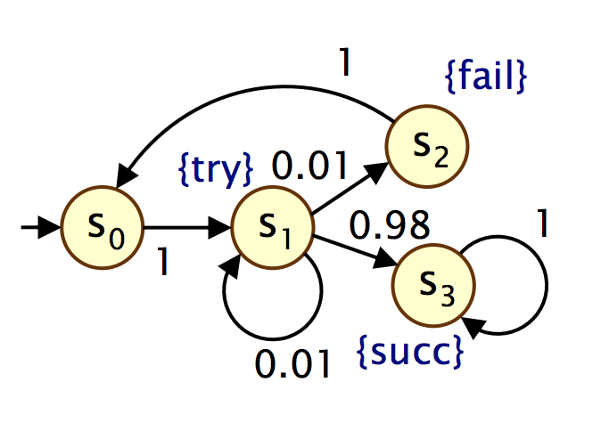
Probabilistic Model Checking[8]
Models are represented as Markov Chains.
Discrete-time Markov Chains:
discrete set of states representing possible system configurations
transitions between states occur in discrete time-steps
probability of making transitions between states is given by discrete probability distributions
Properties expressed in Probabilistic Computation Tree Logic (PCTL)
Temporal logic for describing properties of DTMCs/MDPs
Extension of (non-probabilistic) temporal logic CTL
Example − send → P≥0.95 [ F≤10 deliver ] − “if a message is sent, then the probability of it being delivered within 10 steps is at least 0.95”

Slide 12
Symbolic Executer
Symbolic assignments
At branch instructions
Explore all satisfiable paths
Recorded in path constraint
Tree of execution states is created

Slide 14
Theorem Provers
Find a proof for a given set of axioms and inference rules.
Usually involve a lot of user interaction.
Often utilize symbolic execution and model checking.

Slide 15
Coq Demonstration
Here, I will switch tabs to perform a basic demonstration of the functions of the theorem prover Coq using the Coq IDE.
Notes:
Coq has been used to build verified aspects of systems, including a certified compiler (compCERT) and an ongoing project involving a verified implementation of LLVM (Vellvm)

Slide 16
Verifying Autonomous Systems
Most work has implemented model checking.
Two methods to verify a complex system:
Build an implementable model of the system using formal methods.
Develop an accurate model representation of an existing system using formal methods.
Notes:
The second method is challenging, because you must prove that your representation is, in fact, an accurate one. Most work in verifying autonomous systems has used the former approach of building a system from scratch using a modeling language and a model checker.

Slide 17
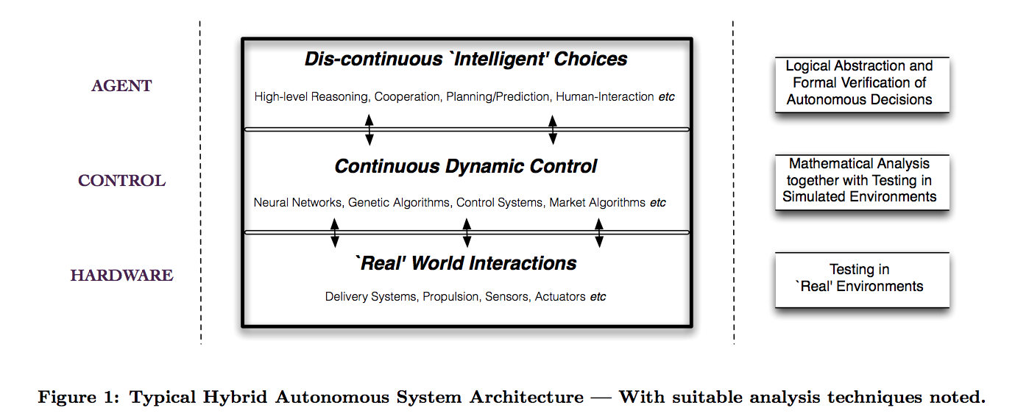
Where formal verification is used [4]

Slide 18
Rational Agents
The autonomous systems are conceptualized as “rational agents”, or agents with explicits reasons for making the choices it does, and the ability to explain them.
Rational agent architecture is made up of Beliefs, Desires, and Intentions.
Beliefs: Agent’s information about itself, other agents, and its environment.
Desires: Long-term goals.
Intentions: Goals the agent is actively pursuing.

Slide 19
What are we verifying?
Since it is hard to predict all possible environmental outcomes of an autonomous vehicle, common practice is to instead focus on what decisions the vehicle makes verifying properties about those decisions.
Want to show: vehicle is making best possible decisions based on an accurate representation of the environment.
In other words: [4]
Notes:
Here, ‘B’ means “the agent believes”, ‘♦’ means “at some future moment in time”, ‘ロ’ means “at all future moments in time”, and ‘I’ means “the agent intends”.

Slide 20
Work that has been done:
A lot of work has gone towards verifying Unmanned Aircraft Systems (UAS), or “a group of elements necessary to enable the autonomous flight of at least one Unmanned Air Vehicle (UAV)”[5].
Notes:
A UAS can include multiple UAVs, a communication link to the ground-based pilot station, and launch-and-recovery systems.

Slide 21
Verifying UAS’s, approach:
Notes:
Challenges: First, the Rules of the Air are neither precise nor unambiguous. Next, the number of rules is too large to tackle them all within this study. Finally, some of the rules implicitly use quite complex notions, such as “likelihood”, “knowledge”, “the other pilot’s intention”, “expectation”, and so on.
The built their model using the modeling language Gwendolen. They used temporal logic in their model checker AJPF.
In this study, they did in fact use a rational agent model. This was to allow more “intelligence” in the UAS agent itself. This extended the agent’s choices to take into account not only the UAS’s situation but also the agent’s beliefs about the intentions of other UAS/aircraft, and to consider more than the literal meaning of the Rules of the Air. Specifically, this can account for the implicit assumptions within these rules.
An example of the rules used to construct the agent is the following: IF aircraft_approaching_head_on THEN turn_right

Slide 22
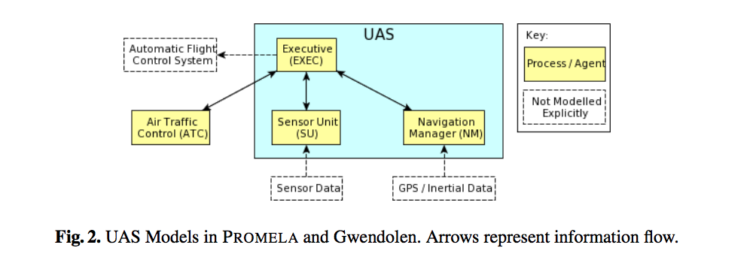
Verifying UAS’s, architecture:
Notes:
This complex architecture took hours to verify on AJPF.

Slide 23
Properties Verified:
Notes:
1. Sense and Avoid: “. . . when two aircraft are approaching head-on, or approximately so, in the air and there is danger of collision, each shall alter its course to the right.” (Section 2.4.10)
2. Navigation in Aerodrome Airspace: “[An aircraft in the vicinity of an aerodrome must] make all turns to the left unless [told otherwise].” (Section 2.4.12(1)(b))
3. Air Traffic Control (ATC) Clearance: “An aircraft shall not taxi on the apron or the manoeuvring area of an aerodrome without [permission].” (Section 2.7.40)
Their model met all of these properties.

Slide 24
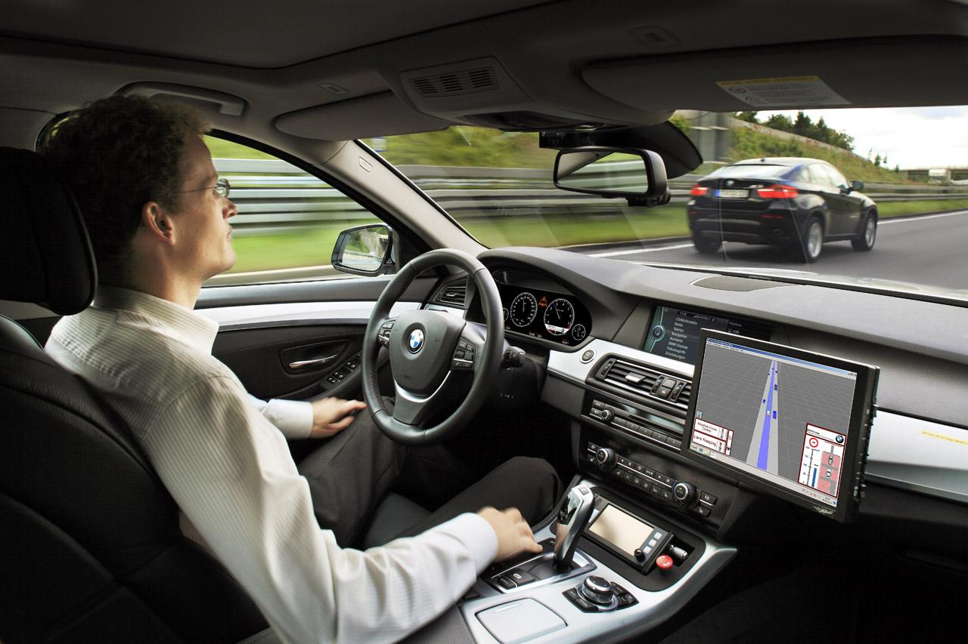
Applying this to Semiautonomous Cars
Driggs-Campbell et al. have done work to create a model of a car that incorporates formal methods to certain aspects of the vehicle.
This includes creating a model of a semiautonomous car and a formal model of the driver. [6, 7]

Slide 25
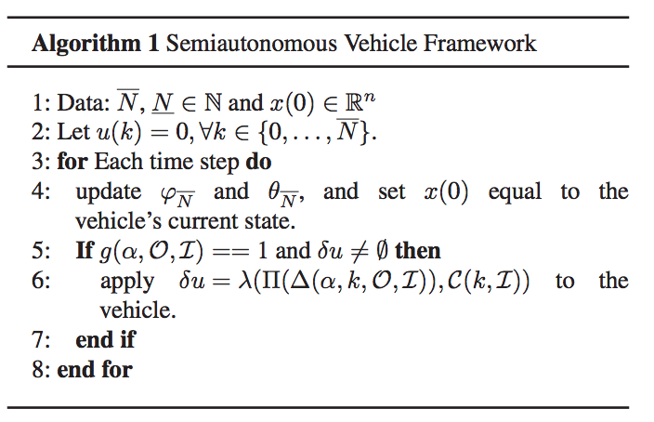
Semiautonomous Model: Vehicle Framework

Slide 26
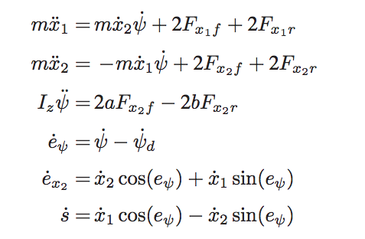
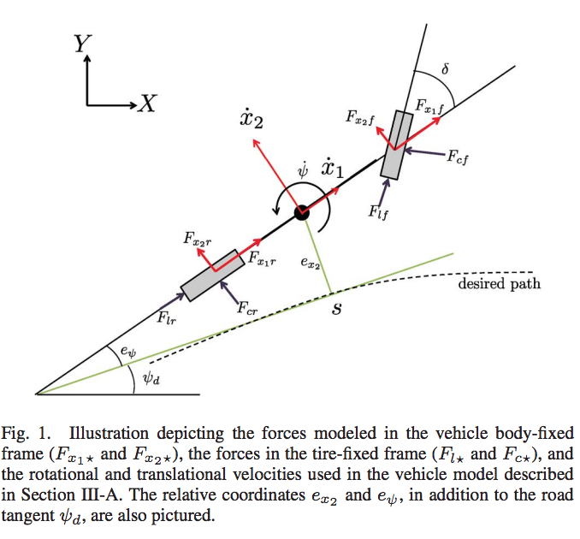
Modeling Vehicle Motion
Safety Constraints:
Notes:
based on the bicycle model
The requirement that the vehicle remain in the free portion of the road is expressed as ex2,min + w ≤ ex2 ≤ ex2,max − w (14) where ex2,min and ex2,max are the bounds determined by the road width and obstacle position at each prediction step. w is the vehicle width.
To ensure that the vehicle operates in a state space where a normal driver can easily handle the vehicle, they constrain the tire slip angles to remain within the linear region.

Slide 27
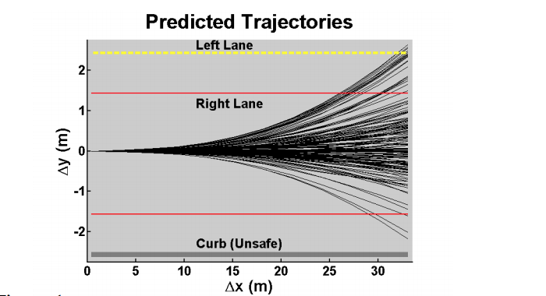
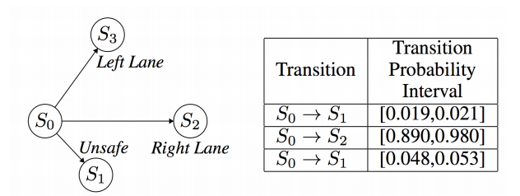
Probabilistic Modeling and Verification of Human Behavior
Model: Convex-Markov Chain; Logic: Probabilistic Computation Tree Logic
A linearized vehicle model is used to generate a trajectory set.
Probability intervals are generated using a determined confidence level.
Notes:
A convex-markov chain with PCTL has polynomial time verification
The states are determined by clusters and labeled according to environmental and driver states

Slide 28
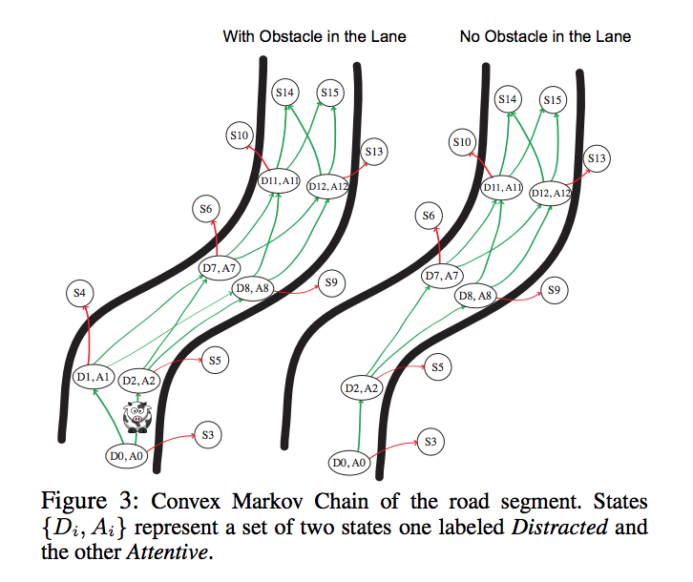
Model of A Complex Maneuver
Notes:
S3-13 are unsafe states and s14 and s15 are safe final states

Slide 29
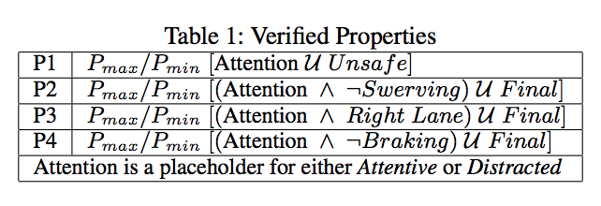
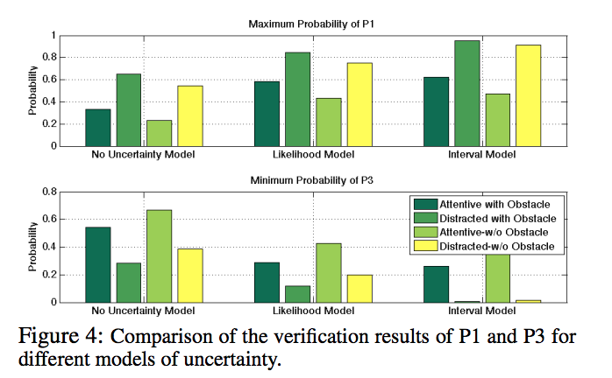
Showing Effectiveness
Notes:
First graph - prob of unsafe state
Second graph - prob of safe state

Slide 30
Thank you for your attention!
Sources:
http://www.cs.cmu.edu/~modelcheck/tour.htm
http://www.cs.cmu.edu/~emc/15-398/lectures/overview.pdf
http://www.cs.ucr.edu/~heng/teaching/cs260-winter2017/symexec.pdf
http://cgi.csc.liv.ac.uk/~matt/pubs/cacm2013preprint.pdf
https://link.springer.com/chapter/10.1007/978-3-642-24270-0_17
http://www.me.berkeley.edu/~frborrel/pdfpub/victor.pdf
http://human-cps.eecs.berkeley.edu/AAAI2014.pdf
http://www.prismmodelchecker.org/lectures/pmc/01-intro.pdf

